Slide 1
Reliving my Geometric Modeling days -☺
Yogesh Kulkarni

Slide 2
Introduction

Slide 3
Introduction
How to model real world objects? - Design
How to put forth ideas in visual manner – Communication
How to verify that design serves the purpose – Analysis
How to get it made? – Manufacturing
All of the above can happen without Computers. But
Better if assisted by Computers/Software
That’s why : Computer Aided < > (CAx)

Slide 4
History
The first source of CAD resulted from attempts to automate the drafting process.
These developments were pioneered by the General Motors Research Laboratories in the early 1960s.
CAD became more widely used after 1970 because of technological advancements.
CAD allowed users to design products much quicker without the production of an actual product.

Slide 5
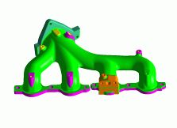
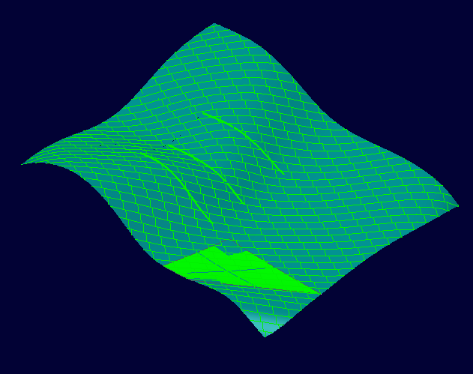
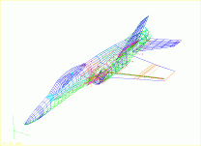
Evolution of CAD Technology
Solid
model
Surface
model
Wire frame
model
Drawing
Notes:
KEY MESSAGE:
This chart highlights the evolution of design geometry from the drawing board through the various stages of CAD design.

Slide 6
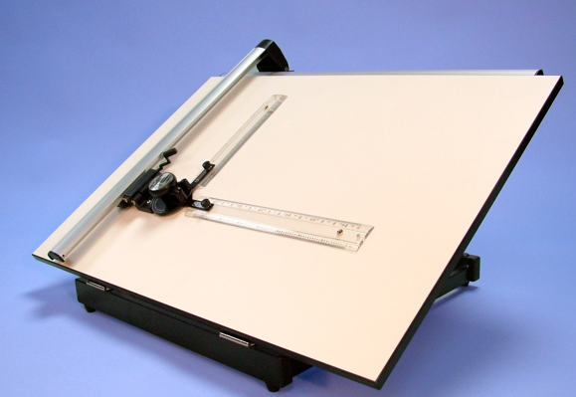
Manual Drafting
Since 1970’s: electronic drafting board

Slide 7
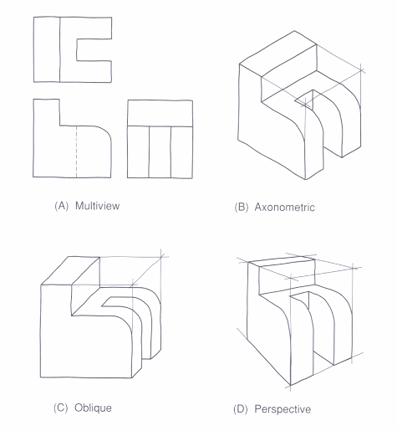
Manual Drafting
2D representations used to represent 3D objects
multi-view drawings
pictorials
Standards and conventions developed so that 3D object could be built from drawings
Drawings created manually or using 2D CAD
Difficult to visualize, error-prone, time-consuming

Slide 8
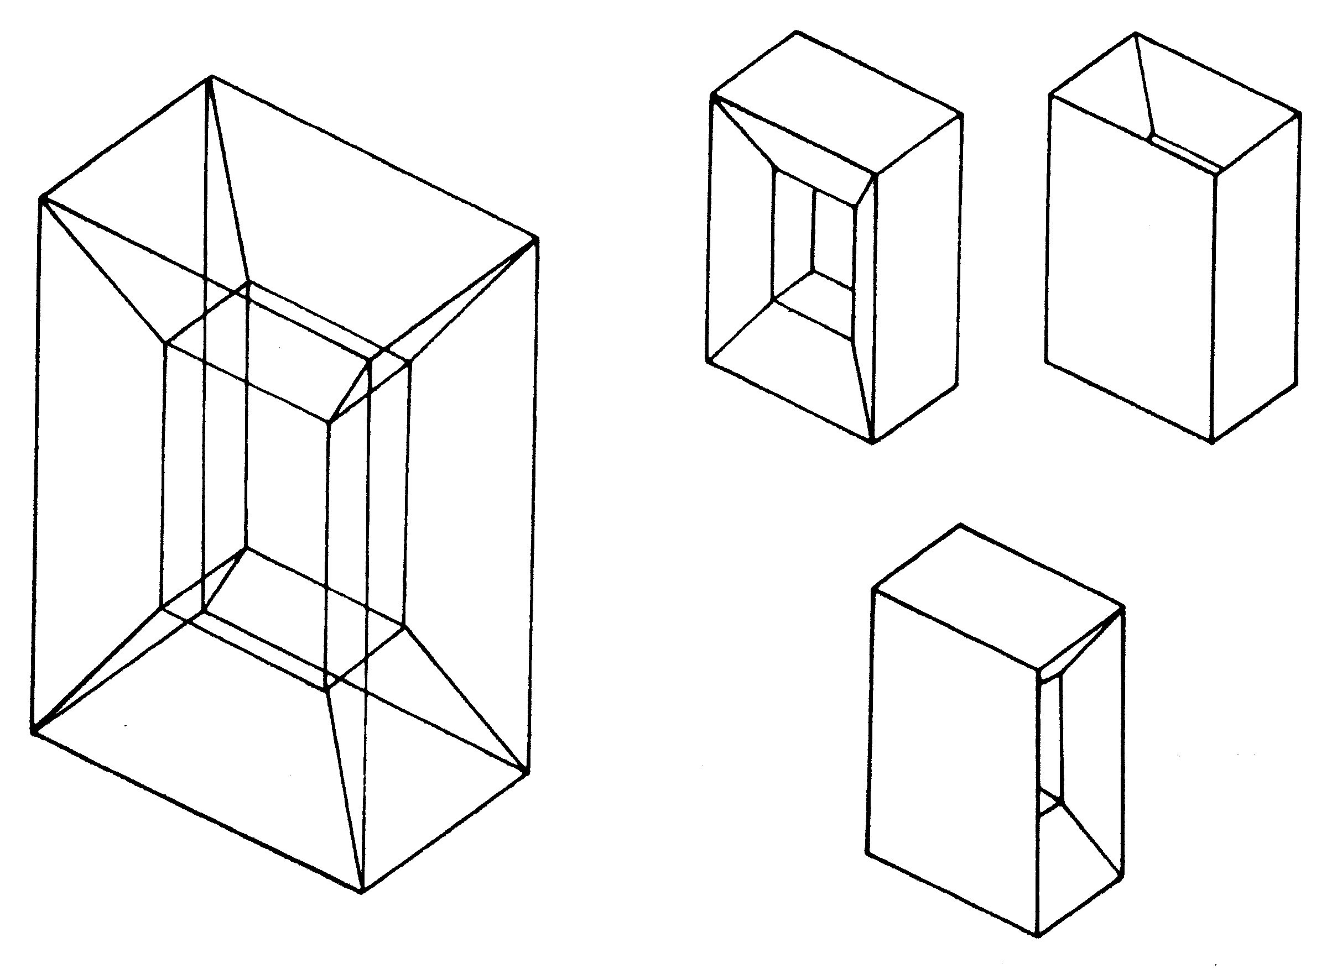
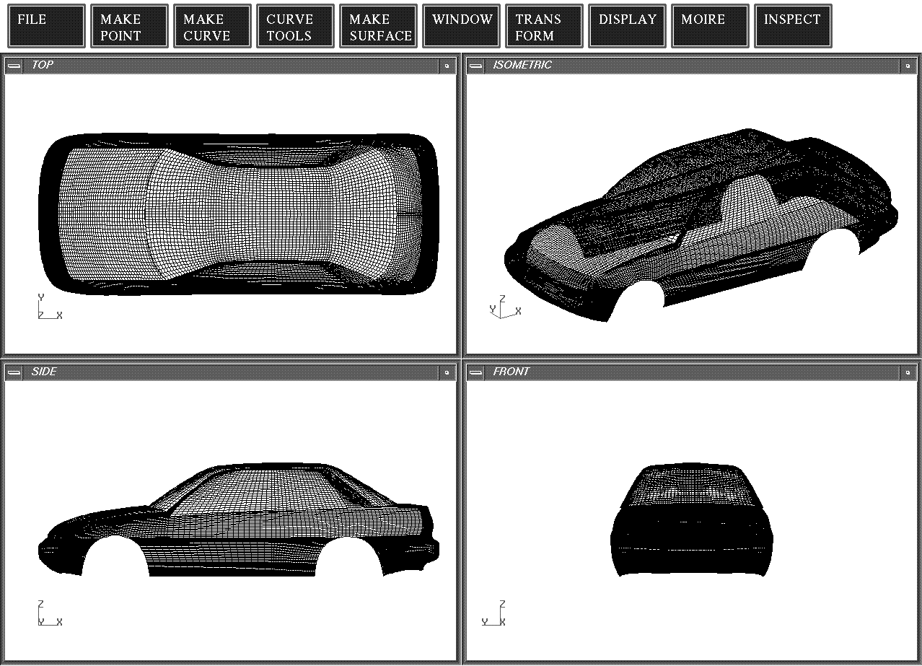
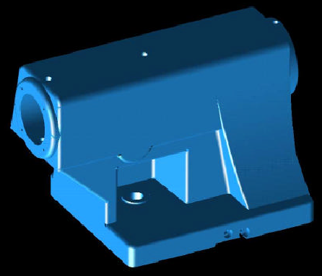
CAD - Types
2D model: Point, line, circular arc, planar curve
3D model
Wire frame
Surface
Solid
Advantages and Disadvantages of each?

Slide 9
2D CAD
Simply replaces manual drawing
Provides a set of drawing tools to create 2D elements
Lines, circles, arcs, etc.
More accurate, easier changes to drawings
Still no 3D representation of the object
Example: AutoCAD

Slide 10
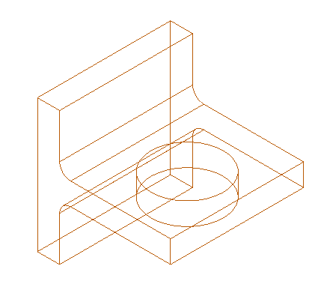
Wireframe
Early 1980’s: wire frame geometry

Slide 11
3D Wire frame Modeling
Geometric entities are lines and curves in 3D
Volume or surfaces of object not defined
Easy to store and display
Hard to interpret - ambiguous

Slide 12
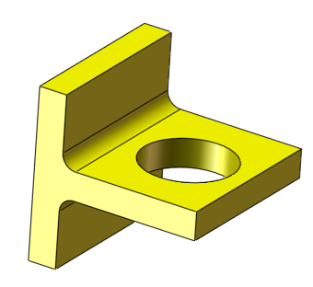
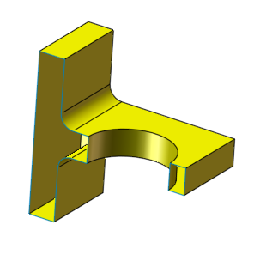
Surface Modeling
Late 1980’s: Surface Modeling

Slide 13
Surface Modeling
Geometric entities are surfaces in 3D
Surfaces have no thickness, objects have no volume or solid properties
Surfaces may be open
Hard to interpret – no information on the interior
A cylindrical surface
May represent a solid cylinder
or a hole

Slide 14
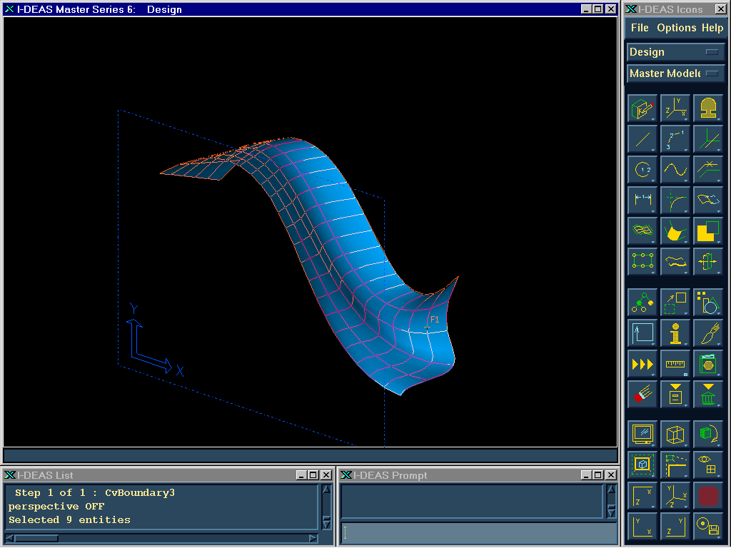
3D Surface Modeling
Notes:
For many applications like computer animation, surface models are sufficient. For engineering design, we want to model objects as solids.

Slide 15
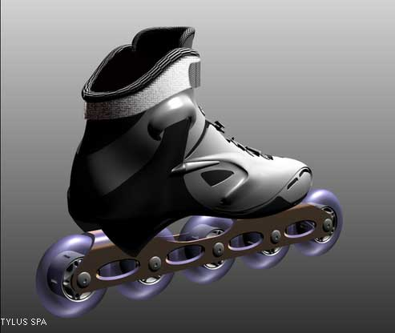
A Surface Model created using Alias StudioTools

Slide 16
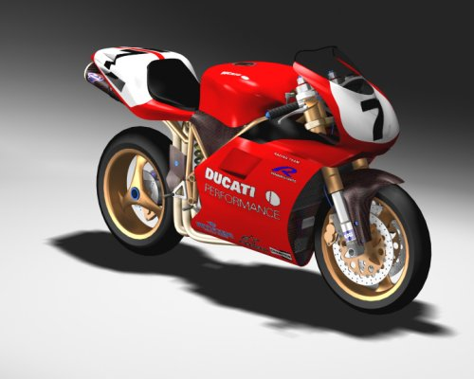
Surface Model created using Rhino

Slide 17
Why draw 3D Models?
3D models are easier to interpret.
Less expensive than building a physical model.
3D models can be altered easily, create more concepts.
3D models can be used to perform engineering analysis, finite element analysis (stress, deflection, thermal…..) and motion analysis.
3D models can be used directly in manufacturing, Computer Numerical Control (CNC).

Slide 18
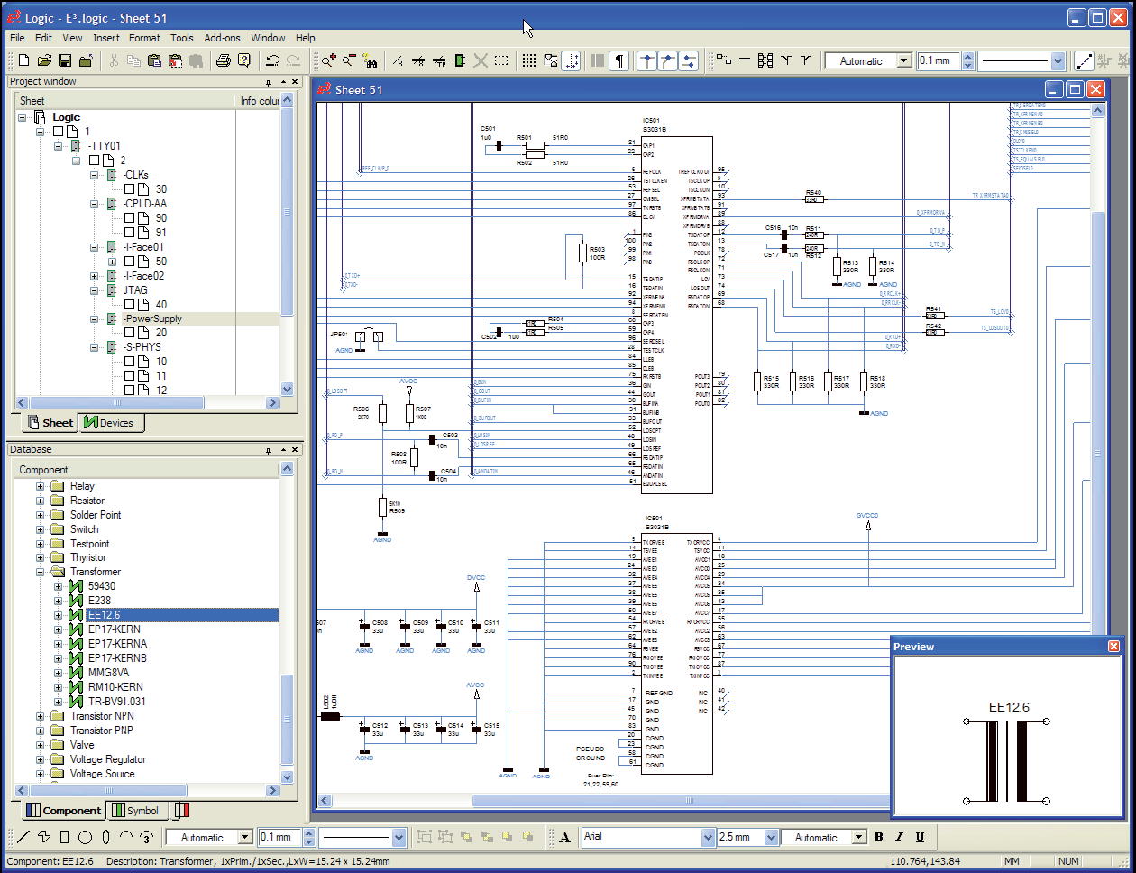
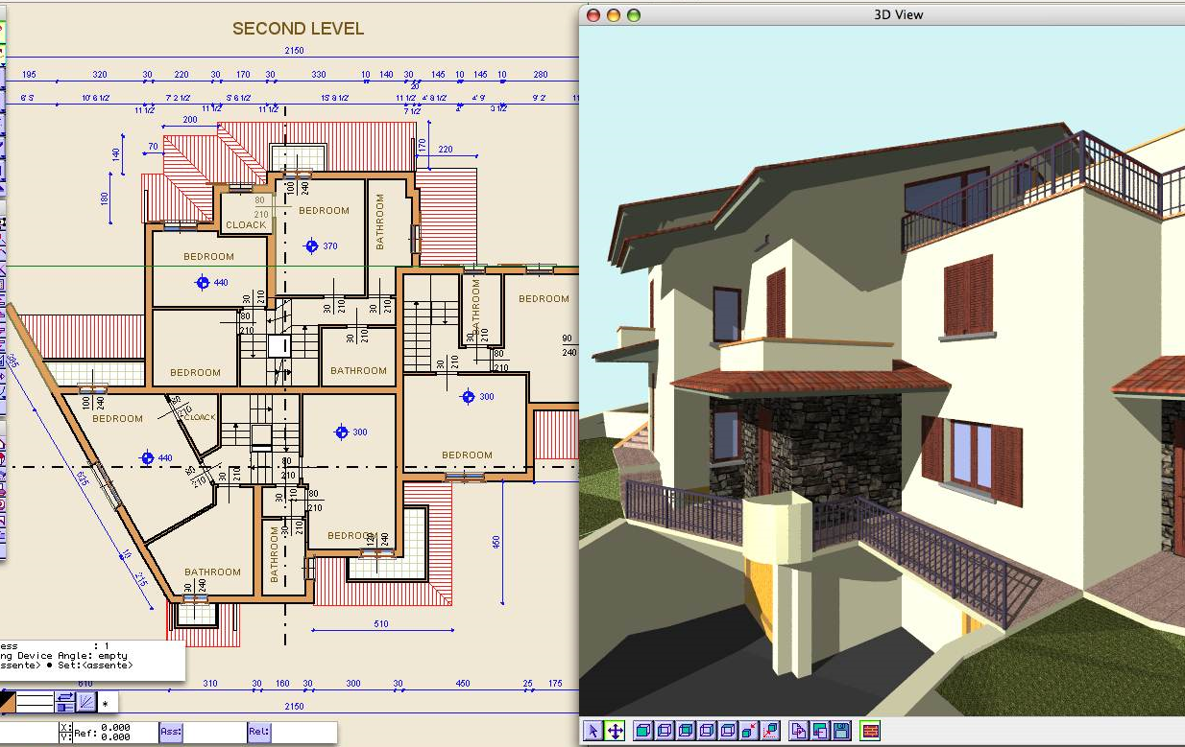
2D Applications
Drafting – sketches, architectures, Drawings
Art – Sketches, painting
Electronic layouts, circuit design

Slide 19
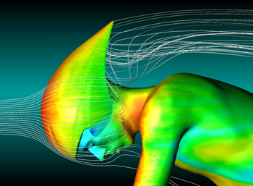
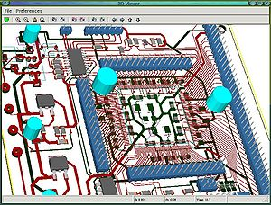
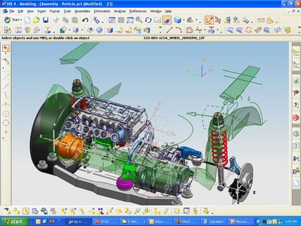
3D Applications
CAD (Computer Aided Design)
CAM (Computer Aided Manufacturing)
CAE (Computer Aided Engineering) Finite Element Method
CG (Computer Graphics)

Slide 20
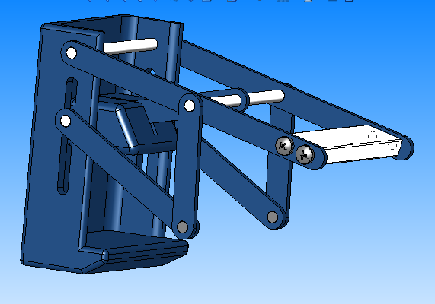
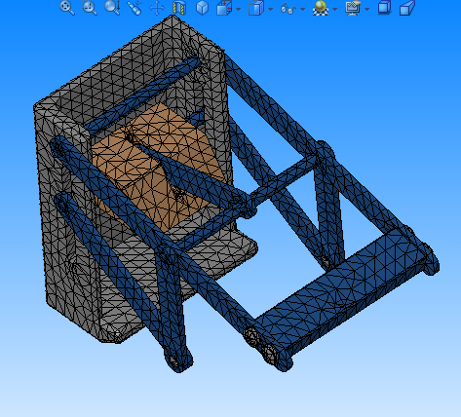
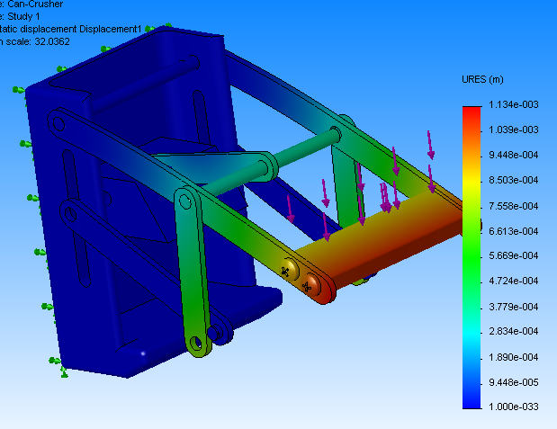
Basics of Finite Element Analysis (FEA)
A complex problem is divided into a smaller and simpler problems that can be solved by using the existing knowledge of mechanics of materials and mathematical tools
Modern mechanical design involves complicated shapes, sometimes made of different materials that as a whole cannot be solved by existing mathematical tools. Engineers need the FEA to evaluate their designs

Slide 21
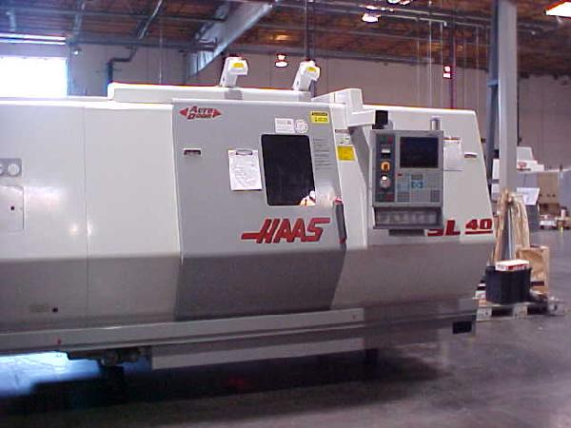
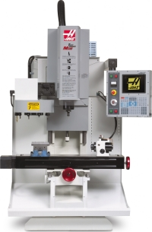
Computer Numerical Control (CNC)
A CNC machine is an NC machine with the added feature of an on-board computer.

Slide 22
Modelling

Slide 23
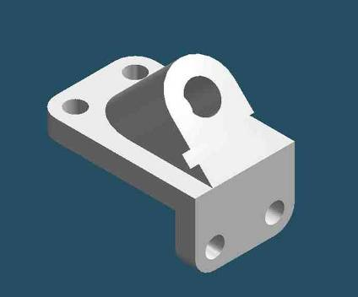
Solid, parametric, feature based modeling
Complete and unambiguous
Solid - models have volume, and mass properties
Feature based - geometry built up by adding and subtracting features
Parametric - geometry can be modified by changing dimensions

Slide 24
MODERN CAE TOOLS
FINITE ELEMENT ANALYSIS
COMPUTATIONAL FLUID DYNAMICS
CAD
SOLID, PARAMETRIC, FEATURE BASED
MOTION ANALYSIS
…..
…..

Slide 25
Solids

Slide 26
What is Solid?
Define Solid?
How would you represent Solid in software (data model)?

Slide 27
Properties of Representation Schemes
Geometric coverage: - objects that can be described using the representation scheme.
Validity - A representation scheme must designate a valid solid.
Completeness - a representation must provide enough data for any geometric computation performed.
Uniqueness - a solid may have more than one representation.
Un-ambiguity - a valid representation should model exactly one solid.

Slide 28
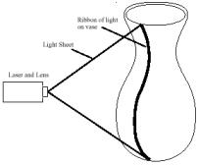
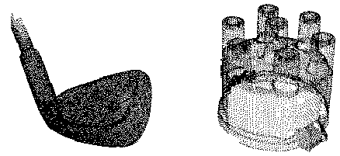
Cloud of points
The simplest form
Unorganized / organized points
Too many points to represent the desired shape
Hard to handle → further processing is required
Obtained by digitizing
CMM (coordinate measuring machine)
Laser range scanner
…

Slide 29
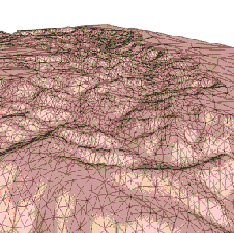
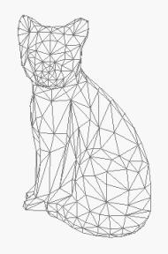
Mesh
Most popular approximation model
Graphics, RP, CAD/CAM, DMU, CAE
Hard to handle
Triangular mesh, Quad mesh, General polygonal mesh
Create mesh by
triangulating cloud of points
faceting exact surface model
Example: 123D Catch

Slide 30
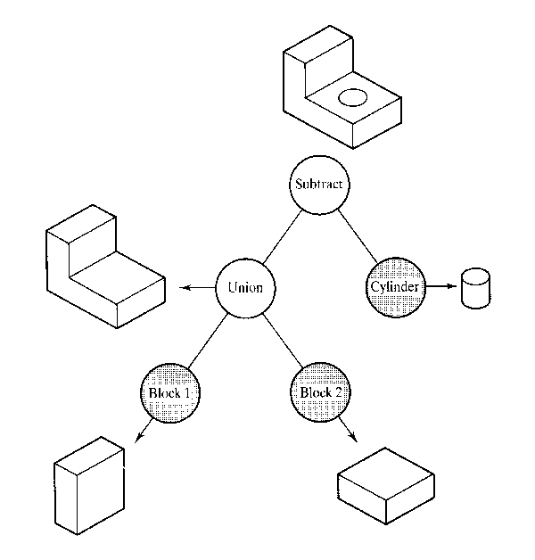
What to store : Modeling procedure
Procedural model: CSG (Constructive Solid Geometry)
Primitive solids with Boolean operation

Slide 31
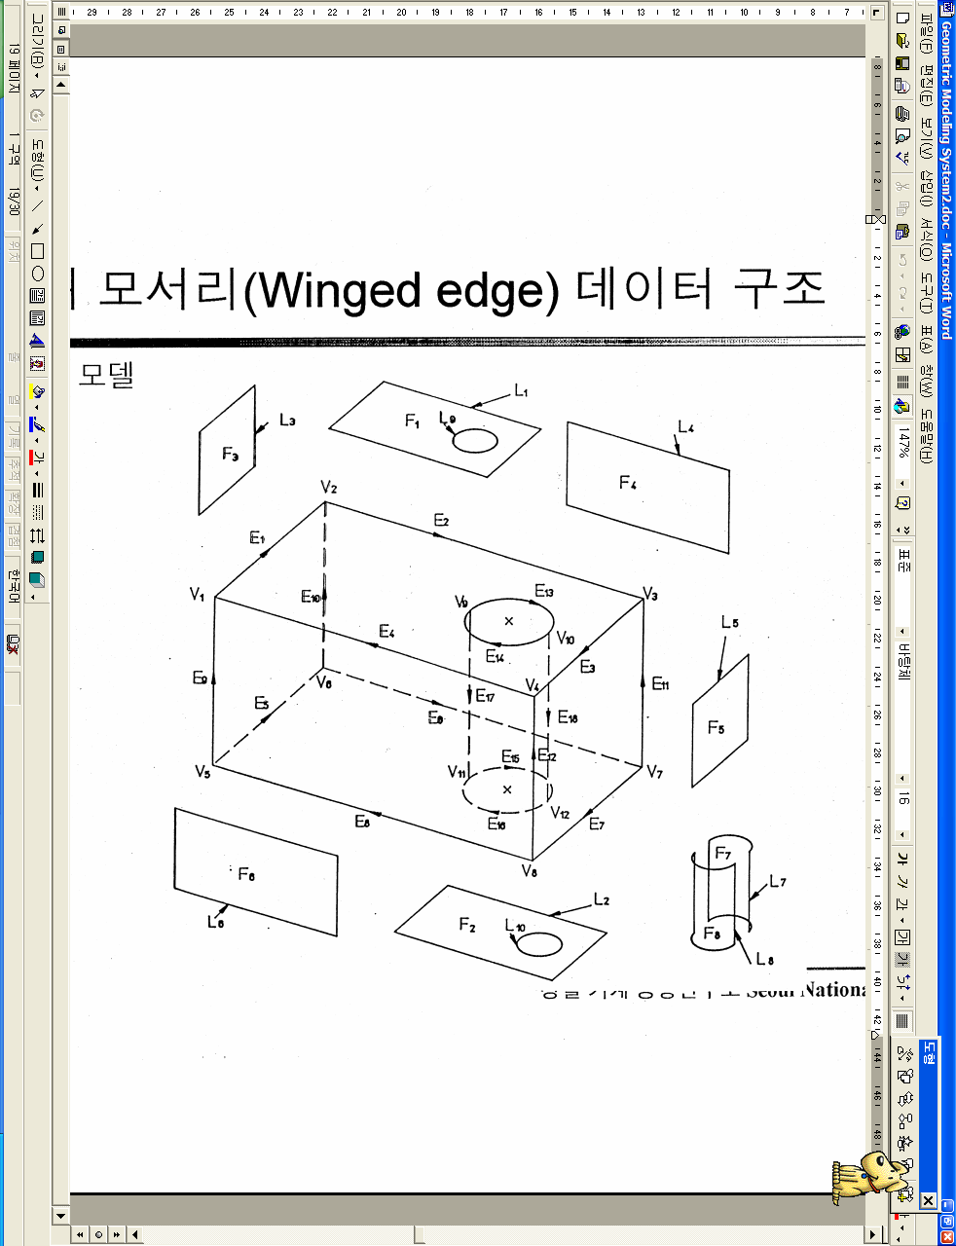
What to store : result
B-Rep (Boundary representation) model : Modeling using bounding surfaces
Topology : connectivity
Geometry : shape

Slide 32
B-Rep model
Topological element
Vertex
Edge
Loop (Edge list)
Face
Lump
Body
Geometrical element
Point
Curve
Composite curve
Surface, trimmed surface
N/A
N/A

Slide 33
Euler-Poincare formula:
For a polyhedron
V - E + F - 2 = 0
V = Vertices
E = Edges
F = Faces
e.g. a block
a prism
a cylinder
a sphere
v = 8, e = 12, f = 6
v = 4, e = 6, f = 4
v = 2, e = 3, f = 3
v = 1, e = 0, f = 1

Slide 34
Extension of solids
A solid can have holes
A face may have a loop or ring of vertices `floating‘, i.e. unconnected by edges to the other vertices of the face
V-E+F-H=2(C-G)
V = Vertices
E = Edges
F = Faces
H = Holes in faces
C = Components (or shells)
G = Genus (holes through solid)

Slide 35
Extension of Euler-Poincare formula to 2-manifolds
“Tweaking” (deformations, twistings, and stretchings but not tearing, or cutting ) solids modifies the solid without changing the topology or the above numbers.
A hollow sphere
(an object with 2 shells)
Object with 1 hole
Object with 1 ring

Slide 36
A solid with holes and loops Quiz

Slide 37
A solid with holes and loops Answer
F = 10(6 plus additional 4)
V = 16, E = 24
R = 2 (as its through hole)
H = 1
10 + 16 = 24 +2 +2 –2(1)
26 = = 26

Slide 38
A solid with holes and loops Example
V – E + F – H = 2 (C – G)
24 – 36 + 15 – 3 = 2( 1 – 1)

Slide 39
Euler Poincare’ Formula
Necessary but not sufficient condition for a valid representation.
Example: 8 vertices, 12 edges, 6 faces

Slide 40
Manifold & Non-Manifold Representation
Manifold surface: - A manifold surface is orient-able if two different sides of the surface can be distinguished. e.g. Orientable surface: sphere, torus
Non-orientable surface: Mobius strip, Klevin bottle

Slide 41
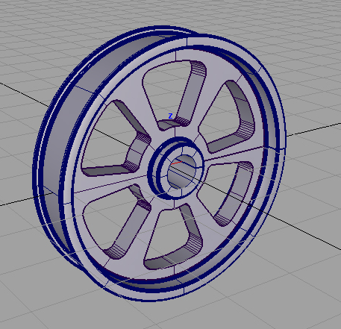
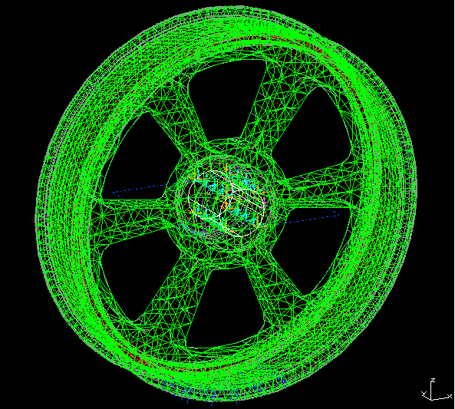
Brep vs Mesh
The object is represented by subdivision/discretization such as mesh and other geometric primitives.

Slide 42
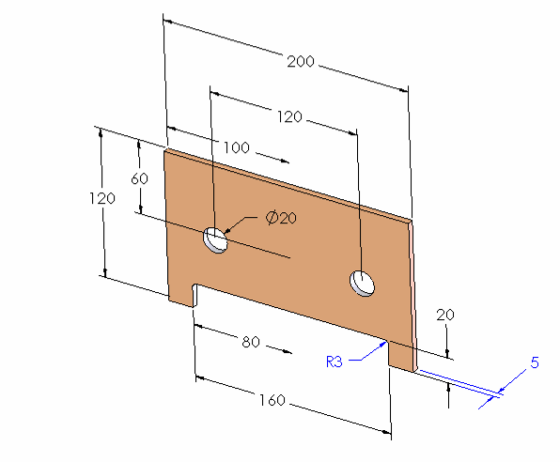
Parametric, Feature-based Solid Model
PARAMETER
SOLID GEOMETRY
BASE FEATURE
(“POSITIVE” SOLID)
CHILD OF BASE FEATURE
(“NEGATIVE” SOLID)
panel 01.SLDPRT

Slide 43
Solid, parametric, feature-based Modeling Software
High-end (more powerful)
NX (UGS)
Catia (Dassault Systémes)
Pro/Engineer (Parametric Technologies Corp.)
Mid-Range (easier to use)
Solid Edge (UGS)
Inventor (Autodesk)
SolidWorks (SolidWorks Corp.)
They all work basically the same way

Slide 44
Feature-Based Solid Modeling
Parts modeled by adding features to a base part
Features represent “operations”
holes, ribs, fillets, chamfers, slots, pockets, etc.
Material can be added or subtracted
Features can be created by extrusion, sweeping, revolving, etc.

Slide 45
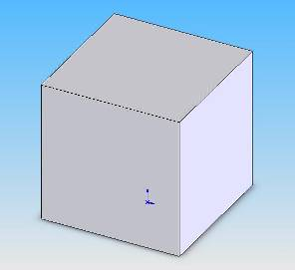
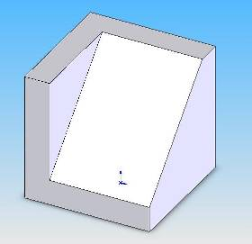
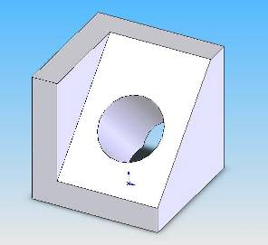
Feature-based Modeling Process
Create base part
Add features until final shape is achieved
Extruded Base
Extruded Cut
Extruded Cut

Slide 46
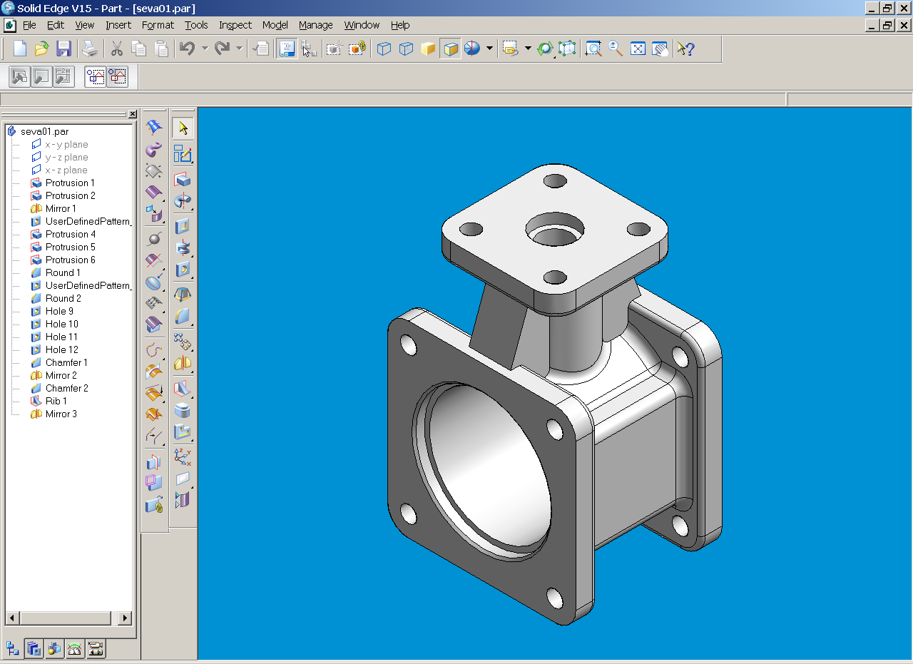
SolidEdge

Slide 47
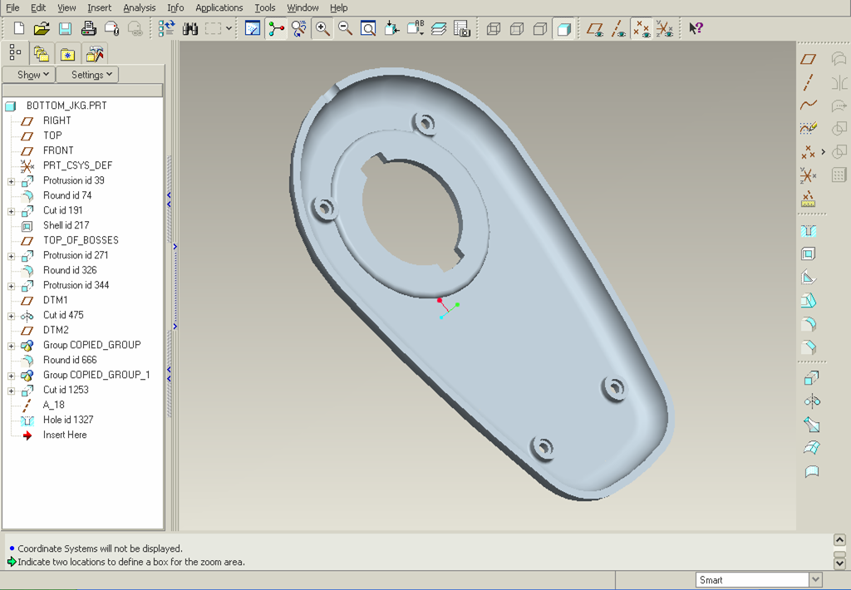
Pro/E Wildfire

Slide 48
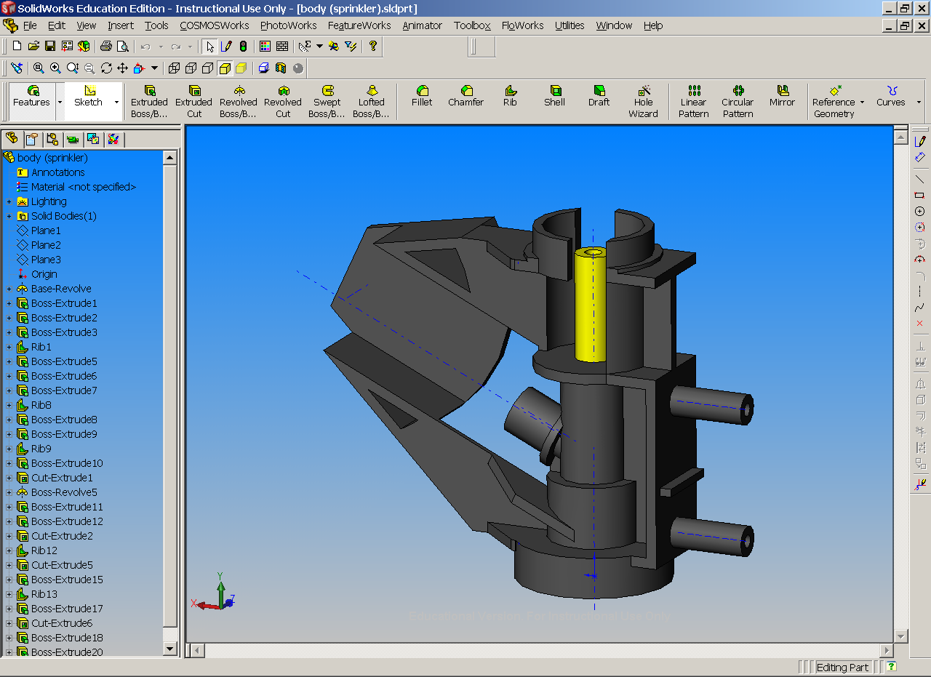
SolidWorks

Slide 49
Modifying Parts
The part is created from the history tree
Features can be added, deleted and re-ordered
Feature parameters can be changed

Slide 50
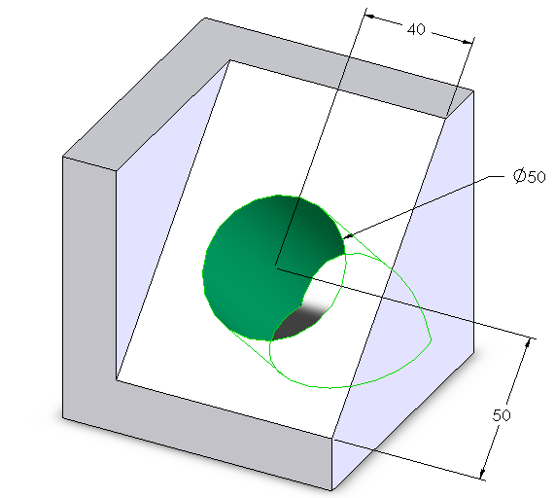
ES1050 part 01.SLDPRT

Slide 51
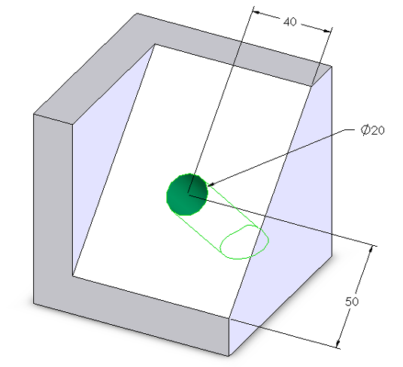
ES1050 part 01.SLDPRT

Slide 52
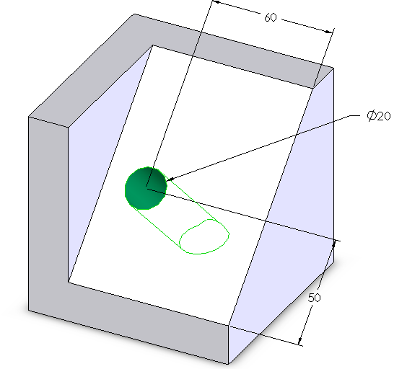
ES1050 part 01.SLDPRT

Slide 53
Summary
Most CAD systems use solid, parametric, feature-based modeling
Parts are modeled by adding features to a base feature
Features can be easily added, deleted and modified
Next time you see a shape…
think how it must have been built!!

Slide 54
References
Ken Youssefi, “Introduction to Solid Modeling”
Texas A & M, “Design Intent and Modeling Tools”
Paul Kurowski, ‘Computer Aided Design (CAD)”

Slide 55

THANK YOU!

